Slide 1

Election Results 2024
by
Rasika Sarode
Shankar Rai
Akash Shinde
Swagath Koyada

Slide 2
INTRODUCTION
Welcome to our presentation on the Election Results 2024. This dataset provides a comprehensive overview of the electoral outcomes across various states and constituencies in the country. It includes detailed information on the candidates, their parties, and the votes they received through different voting methods. This project uses machine learning, SQL, and Power BI to predict the Indian Election 2024 outcomes, providing data-driven insights and visualizations to enhance understanding and engagement in the electoral process.

Slide 3
OBJECTIVES
The objective of analyzing the Election Results 2024 dataset is to understand voting patterns and trends across states and constituencies, evaluate the performance of candidates and political parties, and assess the impact of different voting methods.
We aim to highlight key constituencies, explore demographic and socio-economic influences, and create visual representations to communicate our findings effectively.
Additionally, we seek to forecast future electoral trends and provide actionable insights for political parties and candidates to enhance voter engagement and participation in future elections.

Slide 4
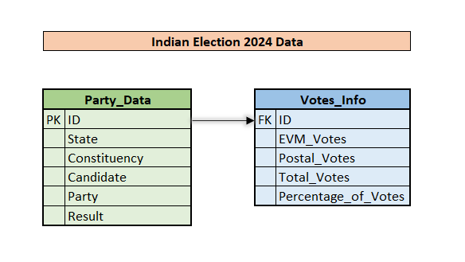
DATASET

Slide 5
SQL Objectives and Solutions

Slide 6
1. Create a view to join both tables to display all results(columns).
Create View FullElectionResults as
Select p.ID, p.State, p.Constituency, p.Candidate, p.Party, p.Result,
v.EVM_Votes, v.Postal_Votes, v.Total_Votes, v.Percentage_of_Votes
from Party_Data p
Join Votes_Info v ON p.ID = v.ID;

Slide 7
2. Create a view, where the candidate won the election in their Constituency (value should be 'Yes' or 'No') along with all columns.
Create View Election_Results as
Select p.ID,p.State, p.Constituency,p.Candidate, p.Party, p.Result, v.EVM_Votes, v.Postal_Votes,v.Total_Votes, v.Percentage_of_Votes,
Case
When Result = 'Won' then 'Yes'
Else 'No'
End as Winning_Candidate
from Party_Data p
Join Votes_Info v ON p.ID = v.ID;
Select * from Election_Results;

Slide 8
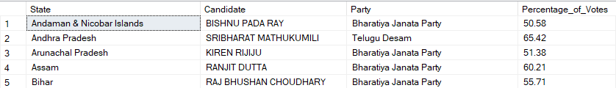
3. Find the candidate with the highest percentage of votes in each state.
Select e1.State, e1.Candidate, e1.Party, e1.Percentage_of_Votes from FullElectionResults e1
Join (
Select State, Max(Percentage_of_Votes) as MaxPercentage from FullElectionResults
Group by State
) e2 on e1.State = e2.State and e1.Percentage_of_Votes = e2.MaxPercentage
Order by e1.State;

Slide 9
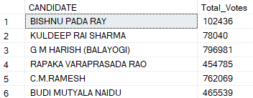
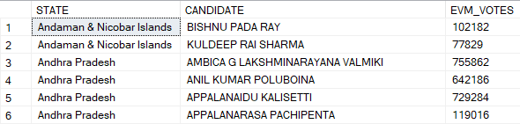
4. List all candidates who received more than the average total votes.
Select CANDIDATE, Total_Votes from FullElectionResults
Where Total_Votes > (Select Avg( Total_Votes ) from FullElectionResults);
5. Find the average EVM votes per state and then list all candidates who
received higher than the average EVM votes in their state.
Select Distinct(STATE), CANDIDATE, EVM_VOTES
from FullElectionResults A
Where EVM_VOTES >
(Select Avg(EVM_VOTES) as AVG_OF_EVM_VOTES
from FullElectionResults B
Where A.STATE = B.STATE)
Order by STATE;

Slide 10
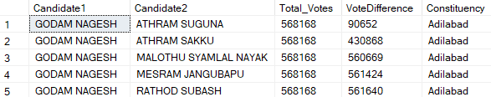
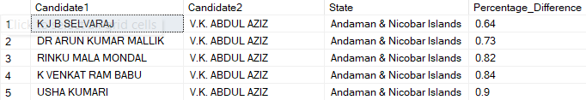
6. List pairs of candidates in the same constituency and the difference in their total votes.
Select A.Candidate as Candidate1,B.Candidate as Candidate2, A.Total_Votes
Abs(A.Total_Votes - B.Total_Votes) as VoteDifference,
A.Constituency from FullElectionResults A
Join
FullElectionResults B on A.Constituency = B.Constituency
and A.Candidate <> B.Candidate;
7. Find pairs of candidates in the same state who have similar percentages of votes (within 1% difference).
Select A.Candidate as Candidate1,B.Candidate as Candidate2,A.State,
Abs(A.Percentage_of_Votes –
B.Percentage_of_Votes)
as Percentage_Difference from
FullElectionResults A
Join
FullElectionResults B on A.State = B.State
Where A.Candidate <> b.Candidate
and Abs(A.Percentage_of_Votes -B.Percentage_of_Votes) <= 1;

Slide 11
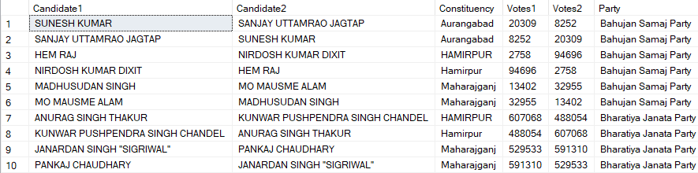
8. List pairs of candidates from the same party along with their constituencies and total votes.
Select A.Candidate as Candidate1,B.Candidate as Candidate2,
A.Constituency,A.Total_Votes as Votes1,B.Total_Votes as Votes2,A.Party
from FullElectionResults A
Join
FullElectionResults B on A.Party = B.Party
Where A.Candidate <> B.Candidate and A.Constituency = B.Constituency;

Slide 12
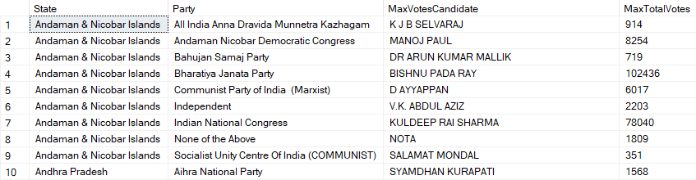
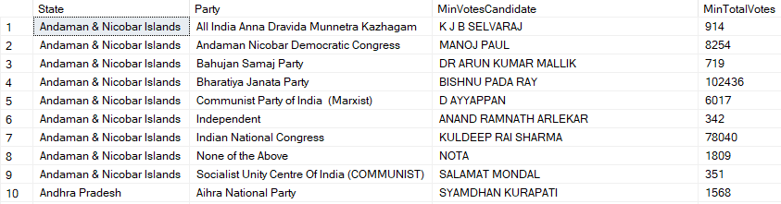
9. Find the candidates within the same party who have the maximum and minimum Total votes in each state.
Select e1.State, e1.Party, e1.Candidate as MaxVotesCandidate,
e1.Total_Votes as MaxTotalVotes from FullElectionResults e1
Join (
Select State, Party, Max(Total_Votes) as MaxTotalVotes
from FullElectionResults
Group by State, Party
) e2 on e1.State = e2.State and e1.Party = e2.Party
and e1.Total_Votes = e2.MaxTotalVotes
Order by e1.State, e1.Party;
Select e1.State, e1.Party, e1.Candidate as MinVotesCandidate,
e1.Total_Votes as MinTotalVotes from ElectionResults e1
Join (
Select State,Party, Min(Total_Votes) as MinTotalVotes
from ElectionResults
Group by State, Party
) e2 on e1.State = e2.State and e1.Party = e2.Party
and e1.Total_Votes = e2.MinTotalVotes
Order by e1.State, e1.Party;

Slide 13
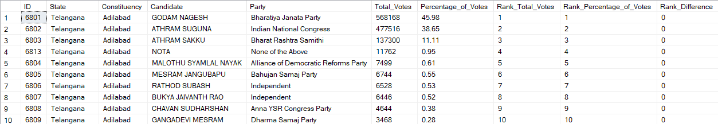
10. Find the difference in ranks between the total votes and the percentage of votes for each candidate within their constituency.
Select ID,State,Constituency,Candidate,Party,Total_Votes,Percentage_of_Votes,
Rank() over (Partition by Constituency Order by Total_Votes desc) as Rank_Total_Votes,
Rank() over (Partition by Constituency Order by Percentage_of_Votes desc) as Rank_Percentage_of_Votes,
Rank() over (Partition by Constituency Order by Total_Votes desc) -
Rank() over (Partition by Constituency Order by Percentage_of_Votes desc) as Rank_Difference
from FullElectionResults

Slide 14
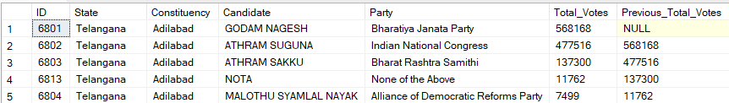
11. Find the total votes of the previous candidate within each constituency based on the total votes.
Select ID,State,Constituency,Candidate,Party,Total_Votes,
Lag(Total_Votes) over (Partition by Constituency Order by Total_Votes desc)
as Previous_Total_Votes
from FullElectionResults;

Slide 15
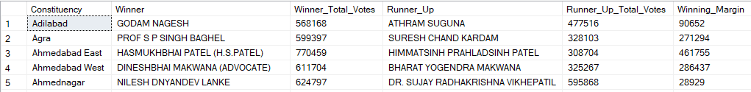
12. Find the winning margin (difference in total votes) between the top two candidates in each constituency.
With RankedCandidates as (
Select p.ID,p.State,p.Constituency,p.Candidate,p.Party,v.Total_Votes,
Rank() over (Partition by p.Constituency Order by v.Total_Votes desc) as Rank
from Party_Data p
Join Votes_Info v on p.ID = v.ID
)
Select
rc1.Constituency,
rc1.Candidate as Winner,
rc1.Total_Votes as Winner_Total_Votes,
rc2.Candidate as Runner_Up,
rc2.Total_Votes as Runner_Up_Total_Votes,
(rc1.Total_Votes - rc2.Total_Votes) as Winning_Margin
from RankedCandidates rc1
Join RankedCandidates rc2 on rc1.Constituency = rc2.Constituency and rc2.Rank = 2
where rc1.Rank = 1;

Slide 16
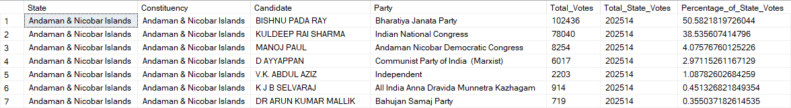
13. Calculate the percentage of total votes each candidate received out of the total votes in their state and list the candidates along with their calculated percentage..
With StateTotalVotes as (
Select p.State,SUM(v.Total_Votes) AS Total_State_Votes from Party_Data p
Join Votes_info v on p.ID = v.ID
Group by p.State)
Select p.State,p.Constituency,p.Candidate,p.Party,v.Total_Votes,stv.Total_State_Votes,(v.Total_Votes * 100.0 / stv.Total_State_Votes) AS Percentage_of_State_Votes
from Party_Data p
Join Votes_info v on p.ID = v.ID
Join StateTotalVotes stv on p.State = stv.State;

Slide 17
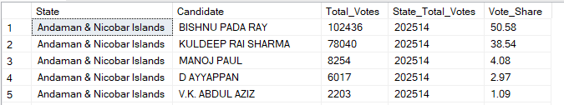
14. Calculate the share of total votes each candidate received out of the total votes in their state.
Select State, Candidate, Total_Votes,Sum(Total_Votes)
over (Partition by State) as State_Total_Votes,
Round((Total_Votes * 100.0 / (Select Sum (Total_Votes)
from FullElectionResults B Where B.State = A.State)),2))
as Vote_Share from FullElectionResults A

Slide 18
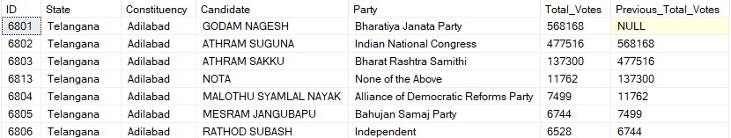
15. List all constituencies where the difference in total votes between the winner and the runner-up is less than 5%.
Select e1.State, e1.Constituency, e1.Candidate as Winner, e1.Total_Votes as WinnerVotes,
e2.Candidate as RunnerUp, e2.Total_Votes as RunnerUpVotes,
((e1.Total_Votes - e2.Total_Votes) * 100.0 / e1.Total_Votes) as VoteDifferencePercentage
from ( Select State, Constituency, Candidate, Total_Votes,
Rank() over (Partition by State, Constituency Orer by Total_Votes desc) as VoteRank
from ElectionResults) e1
Join
( Select State, Constituency, Candidate, Total_Votes,
Rank() over (Partition by State, Constituency Order by Total_Votes desc) as VoteRank
from ElectionResults) e2 on e1.State = e2.State and e1.Constituency = e2.Constituency and e1.VoteRank = 1 and e2.VoteRank = 2
Where ((e1.Total_Votes - e2.Total_Votes) * 100.0 / e1.Total_Votes) < 5
Order by e1.State, e1.Constituency;

Slide 19
Exploratory data analysis

Slide 20
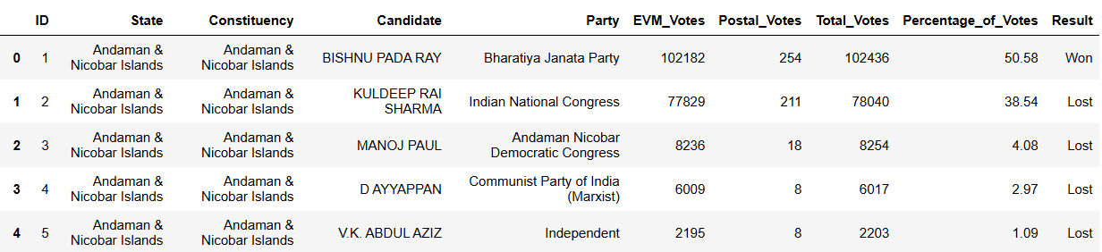
Insights from the Dataset
Data Loading:
Loading data from various sources such as CSV files, Excel sheets, or databases.
Checking Structure of Data:
Examining the dimensions and structure of the dataset using methods like .head() which returns first few columns of the dataset or .info() which can show datatypes or .shape() to get the dimensions of the data or describe() which can generate descriptive statistics of the data.

Slide 21
Pre Processing and Data Cleaning
Renaming of variables: Renamed the variables as per naming convention.
Duplicates Value: We searched for duplicates value but there were none duplicates in dataset.
Formatting values: Missing values were entered as – which replaced with NULLs using list comprehension.
Null Values: Null values were treated by filling with median of respective variables.
Convert column to appropriate data type: Converted object variables to float object.
One hot encoding: Created dummy variables for Result variable, replace the object values into 0,1 in the columns Won, Lost resp.
Outlier Detection: Outliers are not treated because they are numerous and appear to be accurate as per manual observation. Removing the outliers will negatively impact the overall data analysis.

Slide 22
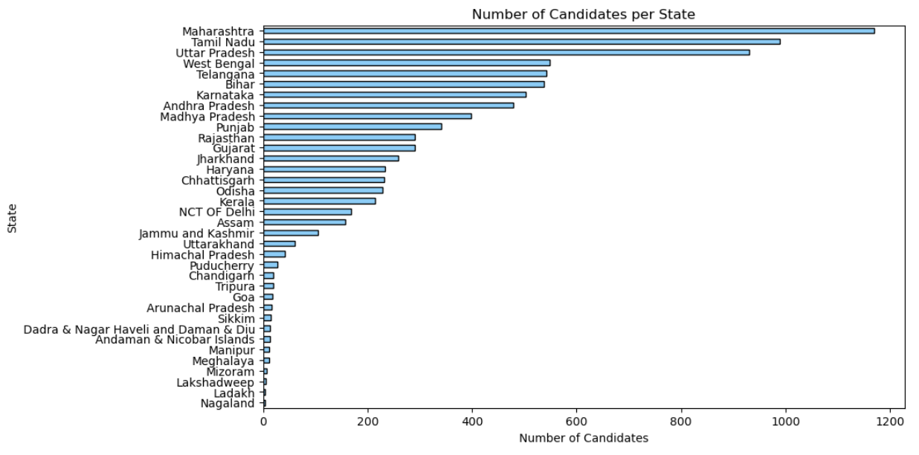
Distribution of number of Candidates per State
Bar Charts are commonly used to compare and visualize discrete data making it easier to understand patterns, trends, relation with the data.
The bar chart displays the number of election candidates per state in India, with Maharashtra having the highest number of candidates, followed by Tamil Nadu and Uttar Pradesh.
States like Nagaland and Ladakh have the fewest candidates.

Slide 23
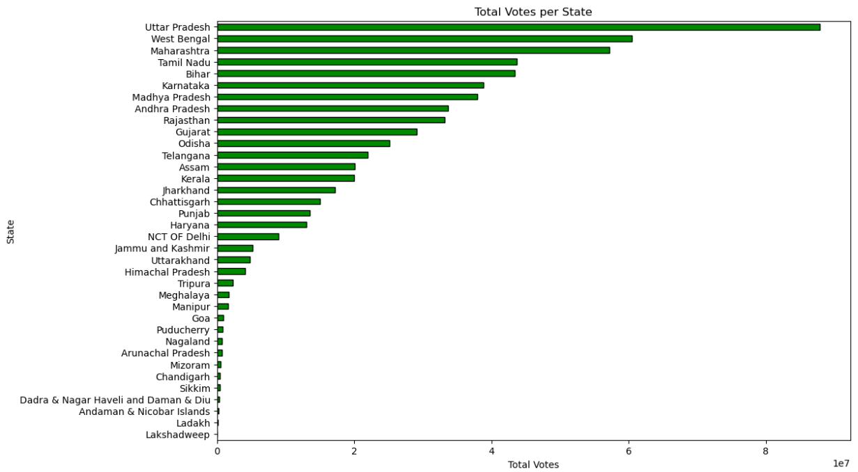
Distribution of Total Votes per State
The bar chart displays the total votes per state in India. Uttar Pradesh has the highest number of votes, followed by West Bengal and Maharashtra.
The chart illustrates the significant variation in voter turnout across different states, with larger states like Uttar Pradesh and Maharashtra having substantially higher vote counts compared to smaller states and union territories like Lakshadweep and Ladakh, which have the fewest votes.

Slide 24
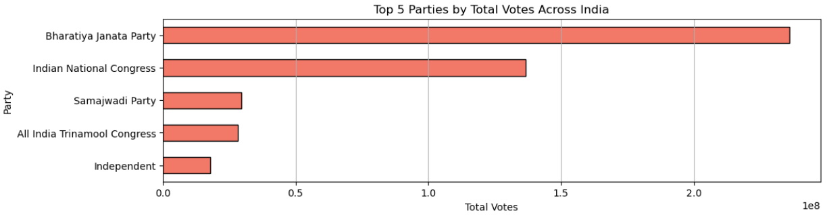
Top 5 Parties by total votes
The Bharatiya- Janata Party received the most votes, followed by the Indian National Congress, the Samajwadi
Party, the All India Trinamool Congress, and finally the Independent party.
This is likely a summary of votes for a particular election, although the election year is not provided.
It is worth noting that "Independent" in this context refers to candidates who are not affiliated with any political party, rather than the country of India itself.

Slide 25
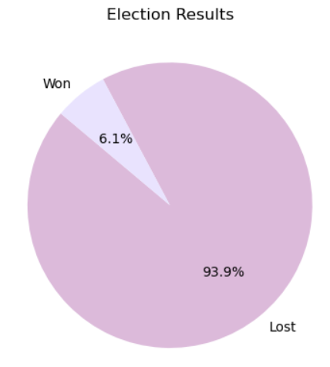
Distribution of Election Results
Pie Charts are commonly used to compare and visualize categorical data where each slice represents a particular category / group.
The entire pie represents 100% of the data.
This pie chart shows the results of an election. The majority of the candidates lost, with only 6.1% winning.
The chart visually demonstrates the overwhelming loss compared to the small number of wins

Slide 26
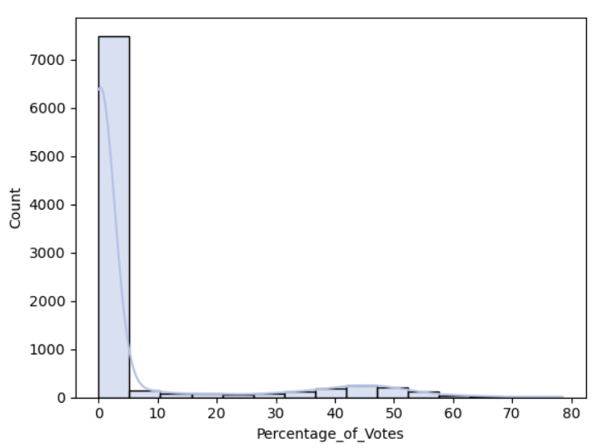
Distribution of Percentage of Votes
Histograms are commonly used to visualize distribution and frequency of numerical continuous data.
In histogram, the shape of the distribution can provide insights into characteristics of data.
This histogram shows the distribution of a dataset where the majority of the data points are concentrated in the lower range of the x-axis (Percentage_of_Votes). This distribution is characterized by a long tail to the right, indicating a few data points with significantly higher values. This kind of distribution is often referred to as a right-skewed or positively skewed distribution.

Slide 27
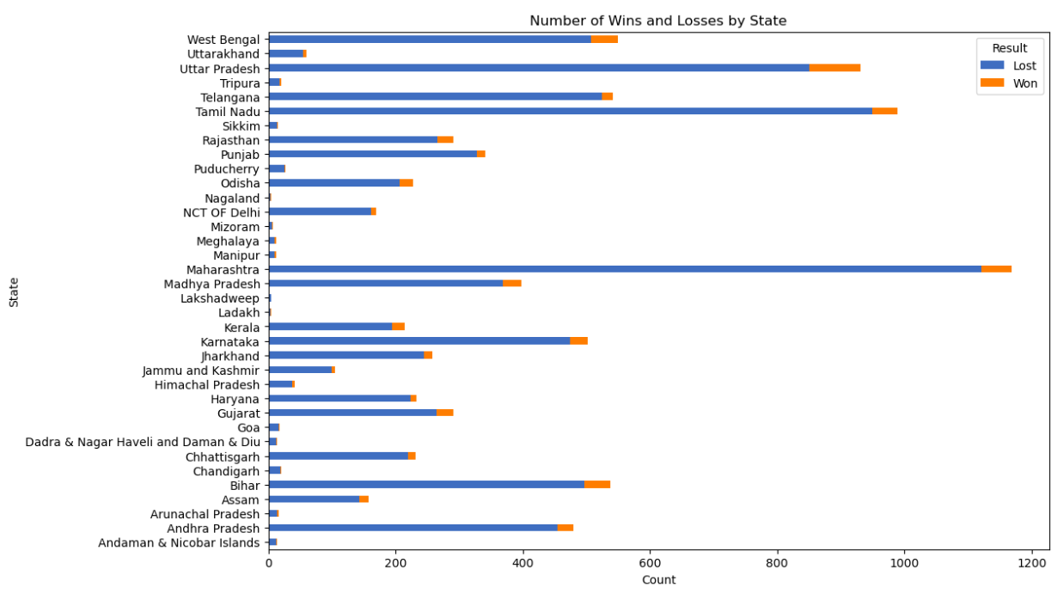
Distribution of Number of Wins and Losses by State
The bar chart shows the number of wins and losses by state in a particular game or competition. Each bar represents a state, with the blue portion representing the number of losses and the orange portion representing the number of wins.
The states are ranked from highest to lowest in terms of total number of wins and losses, with the state with the most wins and losses at the top and the state with the least at the bottom.

Slide 28
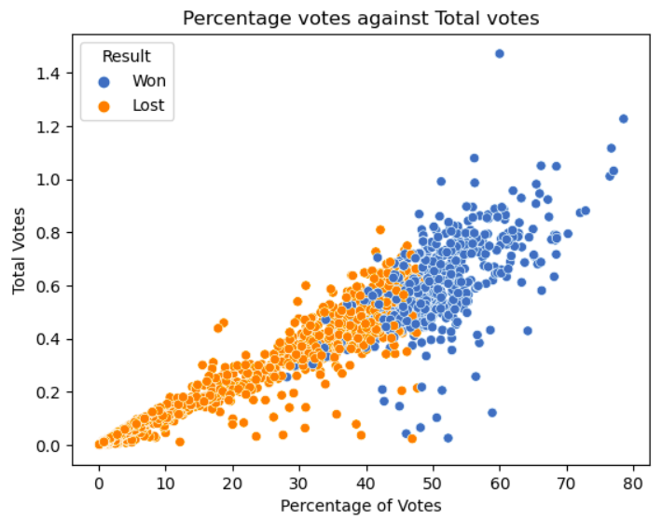
Scatter Plot of Percentage votes against Total votes with Result Correlation
Scatter plots are commonly used to visualize the relationship or association between 2 variables.
The scatter plot shows the relationship between the percentage of votes a candidate received and the total number of votes they received, color-coded by whether the candidate won or lost.
The relationship of Total votes and Percentage votes is almost linear and we can see the Won and Lost as per the plots.

Slide 29
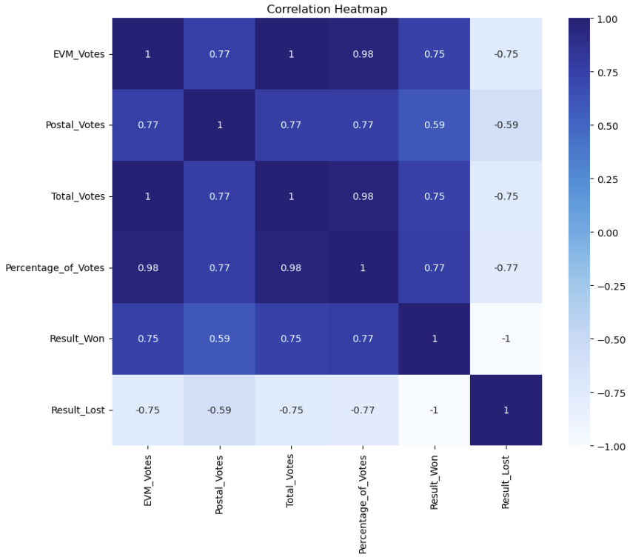
Correlation Heatmap of Voting Data
A heatmap visually represents data through color intensity, illustrating the magnitude of values across a matrix. This technique highlights patterns, correlations, and clusters within the data, making it easy to identify trends.
EVM Votes and Total Votes: There is a perfect correlation (correlation coefficient of 1) between EVM Votes and Total Votes, indicating that they vary in direct proportion with each other.
Percentage of Votes with EVM Votes: There is a very high correlation (correlation coefficient of 0.98) between Percentage of Votes and EVM Votes, suggesting that EVM Votes strongly influence the Percentage of Votes.

Slide 30
Machine learning modules

Slide 31
Feature Engineering: Correlation Analysis:
Feature Engineering and Data Preparation
Feature Selection:
Selecting EVM_Votes, Postal_Votes, Total_Votes, and Percentage_of_Votes as features.Selecting Result as the target variable.
Train-Test Split:
Splitting the data into 70% training and 30% testing sets.
Data Standardization
StandardScaler:
Creating an instance of the StandardScaler to standardize features by removing the mean and scaling to unit variance.
Fitting the StandardScaler to the training data and transforming the training features.
Transforming the testing features using the fitted scaler.

Slide 32
Model training
Algorithms and Models Used: Several machine learning models were explored, including linear regression, decision trees, random forests, and gradient boosting. These models were chosen for their ability to handle complex data and produce accurate predictions.
Explanation of Why These Models Were Chosen: These models were selected based on their performance in similar predictive tasks, their ability to handle large datasets, and their interpretability. Each model offers different strengths, making them suitable for comparison.
Steps in the Modeling Process: The process involved splitting the data into training and testing sets, training the models on the training data, tuning hyperparameters for optimal performance, and validating the models using the testing data.
Details on the Training Process: Models were trained using historical election data and demographic features. Training involved iteratively refining model parameters and assessing performance through cross-validation techniques.
Training and Validation Results: The results from training and validation phases indicated which models performed best on the training data. Metrics such as accuracy, precision, recall, and F1 score were used to evaluate performance.

Slide 33
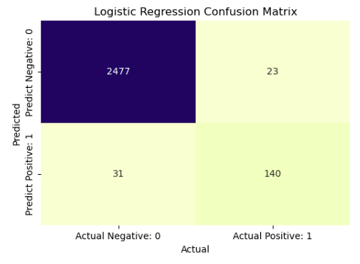
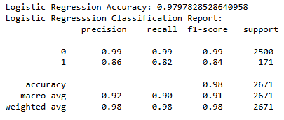
Logistic Regression
Logistic Regression is a statistical model used for binary classification tasks.
It predicts the probability of a target value based on input features, using a logistic function.
Operation: It estimates coefficients for each feature to maximize the likelihood of correctly classifying the target.
Usage: Widely used for its simplicity, efficiency, and effectiveness in binary classification problems.

Slide 34
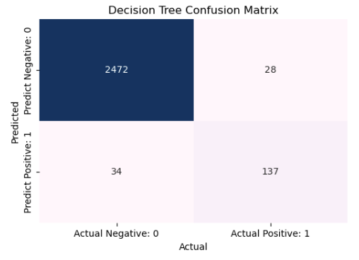
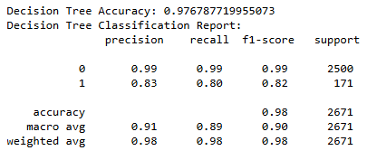
Decision Tree
A decision tree is a predictive model that maps features to conclusions about a target value .
It operates by recursively partitioning the data into subsets based on the most significant attribute at each node, forming a tree-like structure where leaf nodes represent the class labels or outcomes
It widely used in machine learning for its interpretability and ability to handle both numerical and categorical data.

Slide 35
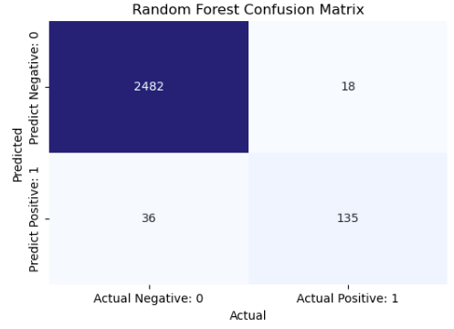
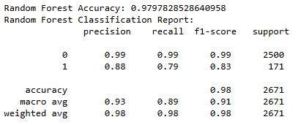
RANDOm forest
Random Forest is an ensemble learning method that combines multiple decision trees to improve prediction accuracy.
It operates by creating many decision trees and averaging their predictions (for regression) or using majority voting (for classification).
Operation: Each tree is trained on a random subset of the data, enhancing robustness and reducing overfitting.
Usage: Popular for its high accuracy, ability to handle large datasets, and resilience to overfitting.

Slide 36
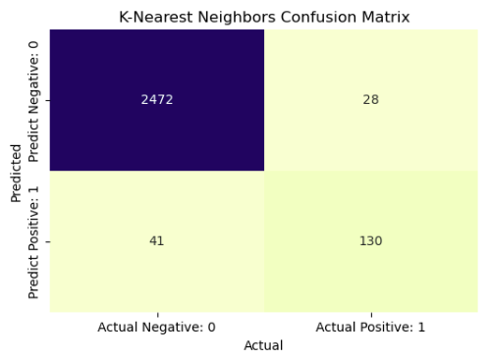
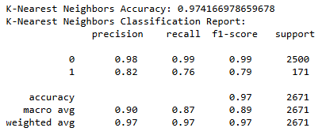
K-Nearest Neighbour
K-Nearest Neighbors (KNN) is a simple, instance-based learning algorithm used for classification and regression.
It operates by finding the 'k' closest data points to the input and predicting the target based on the majority class (for classification) or average value (for regression) of these neighbors.
Operation: Calculates the distance between input features and training samples to find the nearest neighbors.
Usage: Known for its simplicity and effectiveness, especially in small datasets, but can be computationally intensive for large datasets.

Slide 37
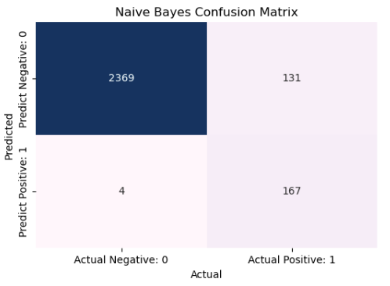
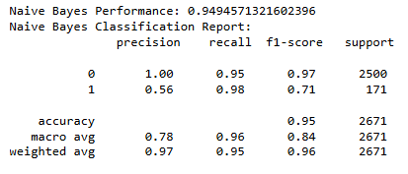
Naive Bayes
Naive Bayes is a probabilistic model based on Bayes' Theorem, assuming independence between features.
It operates by calculating the probability of each class given the input features and selecting the class with the highest probability.
Operation: Uses the likelihood of each feature given a class and the prior probability of the class to make predictions.
Usage: Commonly used for text classification and spam detection due to its simplicity, efficiency, and good performance with high-dimensional data.

Slide 38
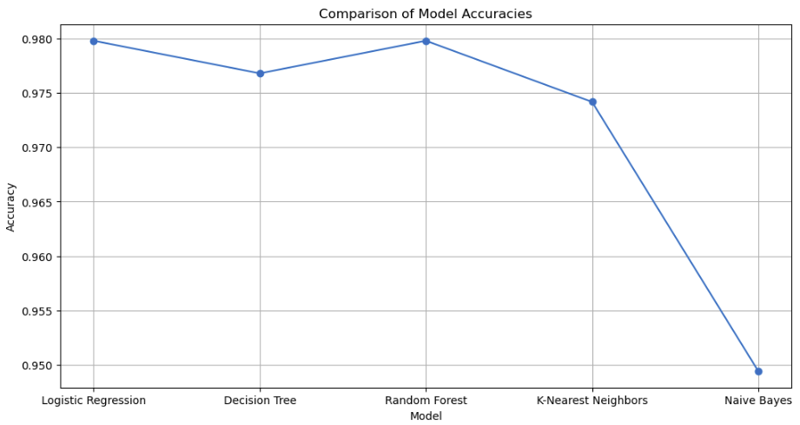
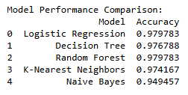
Comparison of all Machine Learning Models
Logistic Regression, Random Forest, and Decision Tree models perform very similarly with high accuracy scores around 97.7% to 97.9%.
These models are well-suited for classification task, indicating robust performance in predicting election outcomes based on the given features and data.

Slide 39
POWER BI Dashboard

Slide 40
USES OF POWER BI DASHBOARD
Visualizing Results: Display vote counts, seat distributions, and winning margins.
Tracking Trends: Analyze voter turnout, party performance over time, and regional patterns.
Demographic Insights: Understand voting behavior based on age, gender, and socioeconomic factors.
Geographical Analysis: Map election results by state, constituency, and district.
Comparative Analysis: Compare historical election data to identify shifts in voter preferences.
Interactive Exploration: Allow users to filter and drill down into specific data points and regions.
Performance Metrics: Evaluate the success of political campaigns and strategies.

Slide 41
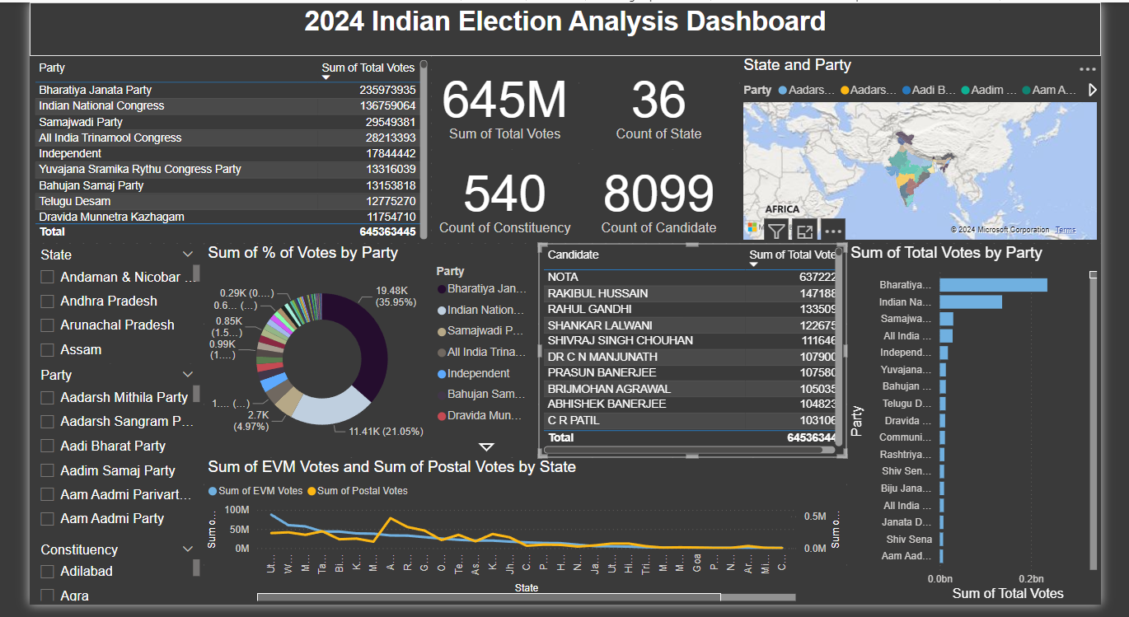

Slide 42
Conclusion
Based on our analysis of the election data, we noticed clear voting trends across different areas, particularly regarding EVM and postal votes.
This analysis highlighted that total votes play a crucial role in determining election outcomes.
Among the models evaluated, the Logistic Regression and Random Forest Model demonstrated superior predictive accuracy in forecasting election results based on available data.

